Slide 1

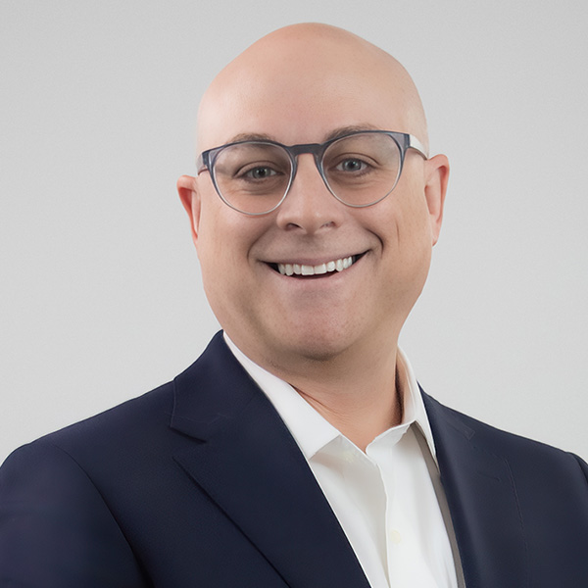
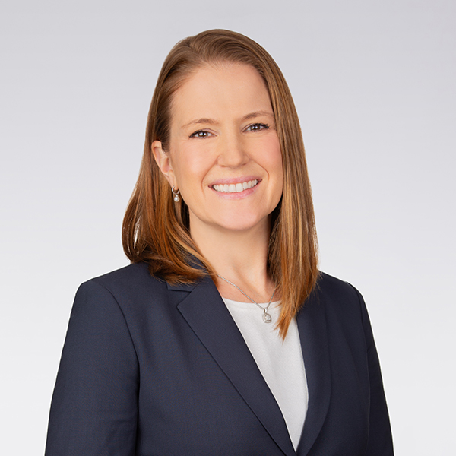
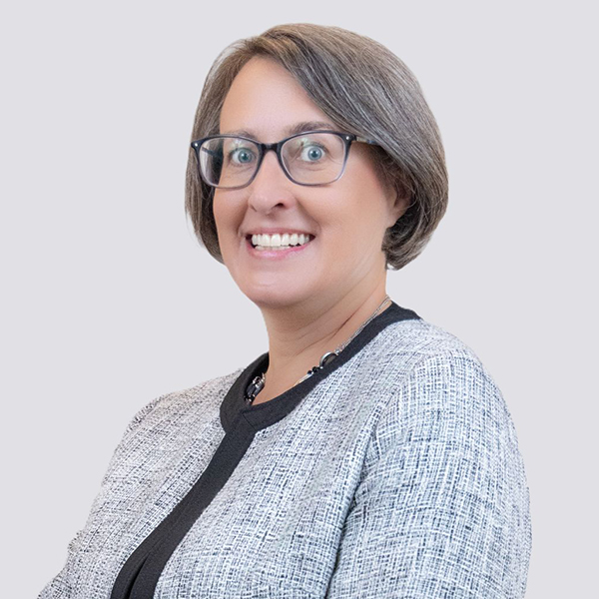
Hot Topics in Food and Beverage Advertising
BBB National Programs National Advertising Division
Phyllis Marcus
Vice President, NAD
pmarcus@bbbnp.org
Ian Barlow
Of Counsel, Wiley
ibarlow@wiley.law
+202.719.4994
Rebecca J. Fiebig
Partner, Wiley
rfiebig@wiley.law
+202.719.3206
Mary Beth Schultz
Partner, Wiley
mschultz@wiley.law
+202.719.3471

Slide 2
Agenda
Background on NAD process, decisions, and referrals
Hot topics
USDA/FDA labeling issues
Trending litigation issues in food and beverage advertising
Recent NAD challenges in the industry
Key substantive themes
Closing thoughts from NAD perspective

Slide 4
BBB National Programs National Advertising Division
Supports truth in the marketplace through review of advertising claims in national advertising
Advertising in all industries - including regulated products and services – in any media
Third-party challenges or monitoring
Appeals to National Advertising Review Board (NARB)

Slide 5





NAD Process… in a nutshell
Challenge filed by companies, trade associations, or by NAD through its monitoring authority.
Challenge articulates express or implied claims challenger believes are not truthful (i.e., unsubstantiated, disparaging)
Burden on Advertiser to support challenged claims.
Depending upon the type of challenge, there can be two rounds of briefing and challenger can offer evidence to rebut advertiser’s evidence
NAD meets separately with each party
NAD Attorney drafts decision
Press release issued

Slide 6
Hot Topics
Made in the USA:
Recent Trump EO told FTC to prioritize enforcement, directed new FTC rulemaking, and also required coordination with other agencies
Increasing emphasis in private litigation
Interesting relationship between FTC and state law
Influencers:
12 of NAD’s Challenges in 2025 involved influencers
Surge in private litigation
NAD: 6 Food and Beverage Challenges in 2025
3 involved 100% claims
Environmental/sustainability claims

Slide 7
Regulatory Agency Labeling Requirements

Slide 8
FDA Claims: What’s Defined, Updated, and Risky
Type of Claim | Requirements | Considerations
Nutrient Content Claims | 21 C.F.R. 101.13; 21 C.F.R. 101.54 – 101.67. | Express v. Implied “Good Source” and “High” Claims
“Healthy” Claims | Food Labeling: Nutrient Content Claims; Definition of Term “Healthy”, 89 Fed. Reg. 106064 (Dec. 27, 2024). | Updated to reflect dietary patterns
“Natural” Claims | Policy-based; not defined. | High litigation and NAD risk

Slide 9
USDA Claims Are Defined Regulatory Categories – Not Flexible Marketing Claims
U.S.-Origin Claims
“Made in the USA,” “Product of USA”
Narrow, defined standards
Organic Claims
Federal certification program (NOP)
Pre‑approved labels
Animal‑Raising Claims
“No Antibiotics Ever,” “Grass‑Fed,” “Humanely Raised”
Claim‑specific substantiation required

Slide 10
Food and Beverage Advertising Litigation

Slide 11
Trending in Litigation
Nutritional content claims
All the protein & all the fiber
Origin claims
Health claims
Preservatives
Natural, Pure
Processed, ultra-processed, minimally processed
Influencer marketing
Greenwashing

Slide 12
Parallels Between What’s Happening at NAD and What’s Happening in Court
All the issues that we’re seeing play out in the courts are either already coming before NAD, or ripe for NAD consideration.
In 2025, NAD handled:
Purity claims (avocado oil)
Origin claims (meat sticks)
Health claims (mushroom coffee & matcha)

Slide 13
Impact of NAD Challenges in Private Litigation
Litigants rely on NAD recommendations in private litigation directly:
To provide factual support for consumer protection complaint
Obillo v. i-Health Inc., 3:24-cv-2459 (N.D. Cal. Apr. 2025)
McKracken v. KSF Acquisition Corp., 5:22-cv-1666 (C.D. Cal. Apr. 2023)
Brown v. SharkNinja Operating LLC, No. 23-21135 (D.N.J. Oct. 2024)
To substantiate allegations of fraud
MacNaughton v. Young Living Essential Oils, LC, 67 F.4th 89, 100 (2d Cir. 2023)
To oppose allegations in complaint
Hayde v. Arcadia Consumer Healthcare Inc., 8:24-cv-2657 (S.D. Cal. Mar. 2025)

Slide 14
NAD Food Industry Challenges of Note
Freshpet, Inc. (Freshpet Dog Food) (March 2026).
Kendal Nutricare Limited (Kendamil Infant Formula) (July 2025).
Cargill Meat Solutions Corporation (Shady Brook Farms Ground Turkey Products) (July 2024).
Ryze Superfoods, LLC (RYZE Mushroom Coffee and RYZE Mushroom Matcha) (September 2025).
JBS USA Holdings, Inc. (Net Zero 2040) (February 2023)

Slide 15
Case Study #1: Freshpet, Inc.
Case #7546 (2026)

Slide 16
Freshpet: Human Grade Dogfood
This was a Fast-Track SWIFT challenge (expedited process for single issue claims) brought by a competitor of Freshpet dogfood.
Challenger argued that video advertisements implied Freshpet’s dog food is human grade.
Human grade claim:
“We give him Freshpet Fresh from the Kitchen Home Cooked Chicken Recipe” and
Freshpet dog food is “made with the same level of quality I want in my own food.”
NOT a human grade claim
Food being prepared in a home kitchen and then Freshpet dog food was served to a dog.
Key aspect was dog being served its own meal from a package of Freshpet taken from the refrigerator.
Takeaway: context matters for net impression

Slide 17
Case Study #2: Kendal Nutricare Limited
Case #7422 (2025)

Slide 18
Kendal Nutricare Limited
Clean Claims
“The most clean formula on the market”
“Clean Recipes – When it comes to our recipe we don’t make compromises.”
Additives Claims
“We don’t do palm oil, corn syrups, soy, fish oil, or other cheap additives”
More Nutritious Claims
“Think all milk is the same? Thanks to organic certified European farms, our cows enjoy a natural diet . . . . This translates into milk that’s not just richer in essential vitamins A, K2, and E . . . .”
“This natural goodness translates into milk that’s richer in fatty acids and essential vitamins A, K2 & E.”
The Natural Claims
“Wholesome by Nature”
“Natural Goodness. Creamy whole milk & lactose from grass-fed cows.”

Slide 19
Case Study #3: Cargill Meat Solutions Corporation
Case #7320 (2024)

Slide 20
Issue Spotting Claims That May Invite Competitor Challenges, Part 1
Express Comparative Claims
Shady Brook Farms ground turkey is preferred for taste over nearly all leading competitor’s products.
Shady Brook Farms ground turkey is “juicier” and “more flavorful” than nearly all leading competitor’s products
Shady Brook Farms ground turkey is generally preferred over nearly all leading competitor’s products

Slide 21
Issue Spotting Claims That May Invite Environmental Challenges, Part 2
Implied Claims
The packaging of Shady Brook Farms ground turkey is less harmful to the environment than 85% of market competitor’s products.
The packaging of Shady Brook Farms ground turkey does not compromise the environment in any manner.
The entire packaging can be collected, separated, or recovered from the waste stream through an established recycling program for reuse or use in manufacturing or assembling another item.

Slide 22
Case Study #4: Ryze Superfoods, LLC
Case #7492 (2023)

Slide 23
Ryze Superfoods Mushroom Coffee and Matcha
This was a challenge NAD initiated through its market place monitoring program.
Ryze voluntarily discontinued the claims at issue.
Express claims:
all-day energy
sharper focus
healthier digestion
better immune support
better sleep.
Possible implied claim that Mushroom Matcha provides the same appetite-suppressing benefits as GLP-1 agonists without the side effects.

Slide 24
Case Study #5: JBS Net Zero 2040
Case #7135 (2023)

Slide 25
Challenged Net Zero Claims
“JBS is committing to be net zero by 2040”
“Global Commitment to Achieve Net-Zero Greenhouse Gas Emissions by 2040.”
“Bacon, chicken wings and steak with net zero emissions. It’s possible.”
“Leading change across the food industry and achieving our goal of net zero by 2040 will be a challenge. Anything less is not an option.”

Slide 26
NAD Analysis of Net Zero Claims
Aspirational Claims Require Substantiation
JBS stated claims were aspirational goals, while challengers argued they implied current credible progress toward net zero.
NAD found that aspirational environmental benefit claims create reasonable expectations from consumers and therefore require substantiation.
A key point is that “net zero” emissions by 2024 is a measurable outcome, and net zero is a recognized standard.
Here, NAD found that consumers would reasonably expect that the company has a plan it is presently implementing to reach this

Slide 27
Key Substantive Themes and Tips
Health impact of food is a surging social and political issue. This means scrutiny about substantiation may increase.
Consumer perception “under the circumstances” about what an ad conveys or means may change over time and across media.
Comparative claims may trigger competitor challenges.
Consider a copy test.
Many respondents voluntary discontinue claims after NAD challenges.

Slide 28
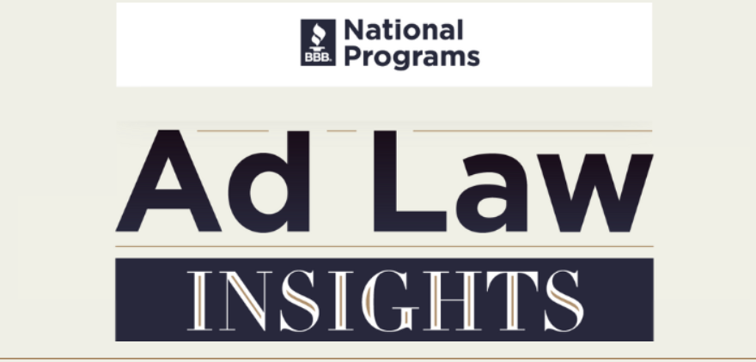
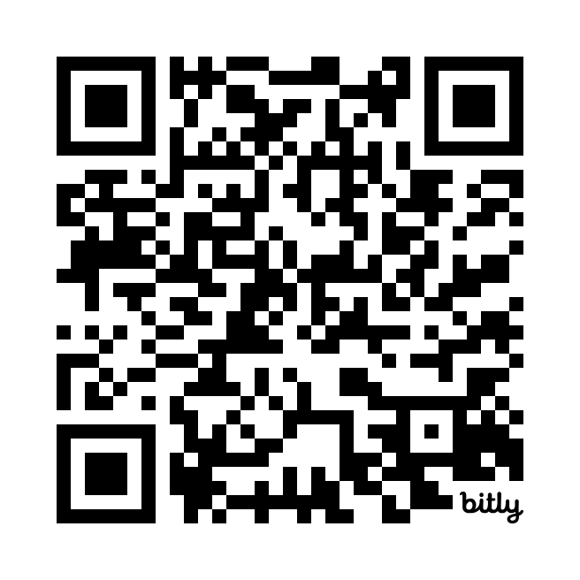
Each month receive insights on recently released advertising law case decisions, stay up-to-date on ad law industry news, get ad law trends from the National Advertising Division, learn about upcoming events, and more.
SUBSCRIBE NOW

Slide 29
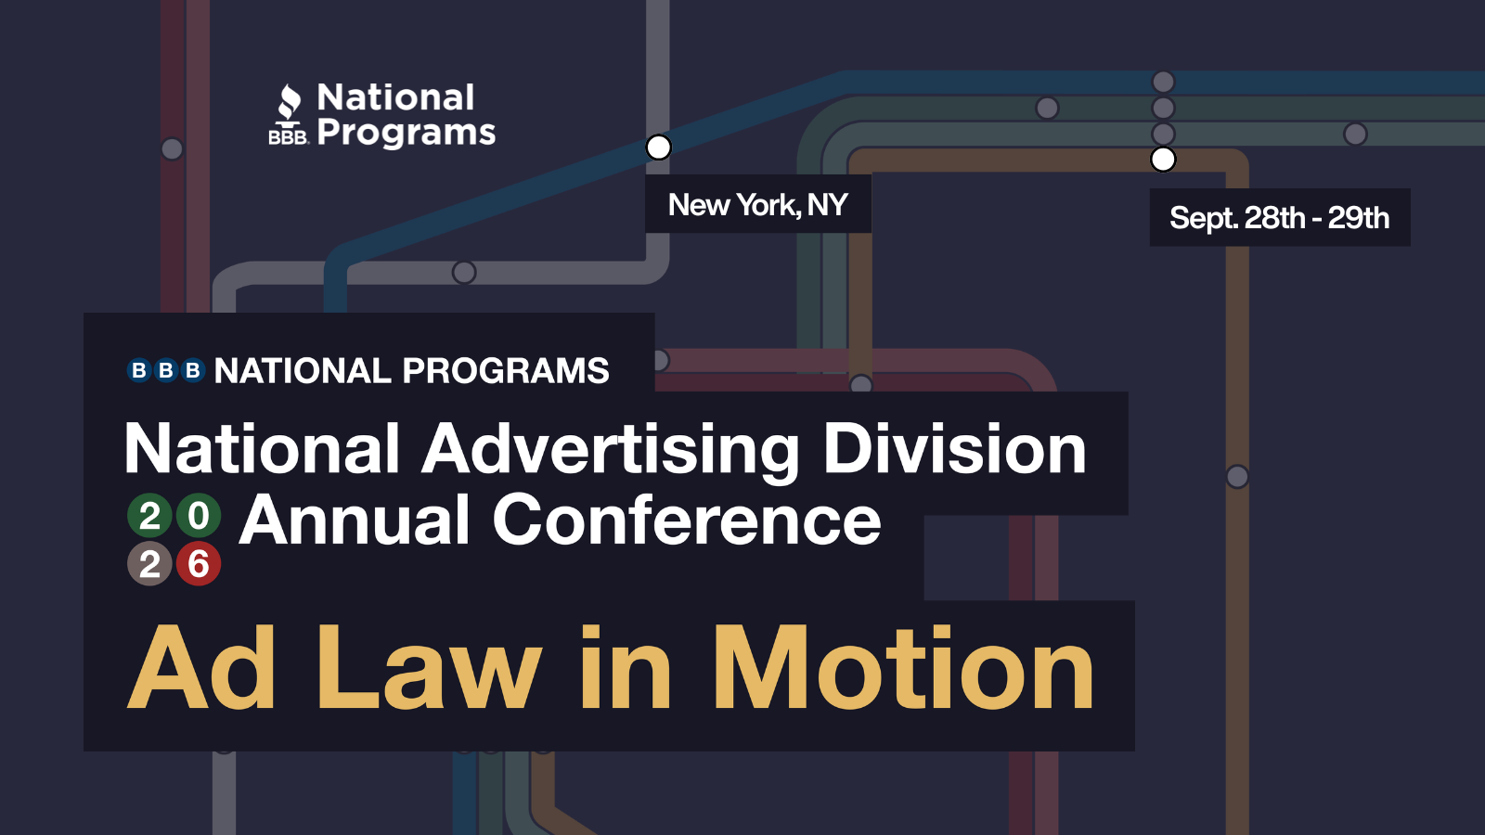
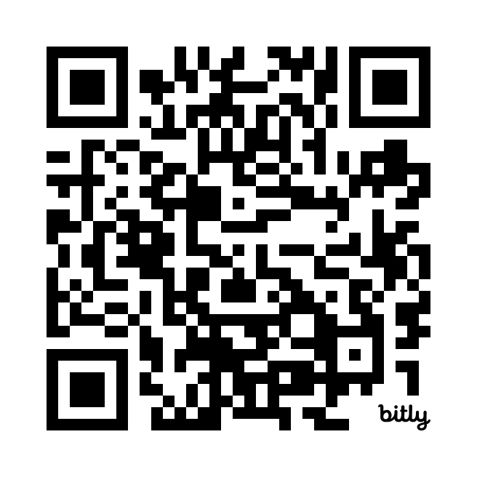

Slide 30
Questions? Feel Free to Follow-Up
Phyllis Marcus
Vice President, NAD
pmarcus@bbbnp.org
Ian Barlow
Of Counsel, Wiley
ibarlow@wiley.law
+202.719.4994
Rebecca J. Fiebig
Partner, Wiley
rfiebig@wiley.law
+202.719.3206
Mary Beth Schultz
Partner, Wiley
mschultz@wiley.law
+202.719.3471

